Slide 1
Computer Engineering 12 Class 9
Instructor: Yuhong Liu
Office: Bannan 324 F
Email: yhliu@scu.edu
Tel: 408-551-3513

Slide 2
Recall: Queue and Stack (ADT)
Queue:
operations – enqueue and dequeue
data structure - we’ve introduced array (possible to use others)
Stack:
operations – push, pop and top
Data structure – we’ve introduced array (possible to use others)
Please note that Queue only allows operations on its two ends. Stacks only allows operations on its top end.

Slide 3
A General Linear List (ADT)
A general linear list: a list in which operations, such as retrievals, insertions, changes and deletions, can be done anywhere in the list, that is, at the beginning, in the middle, or at the end of the list.

Slide 4
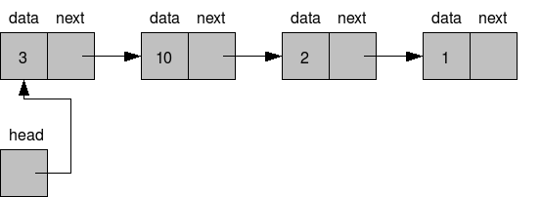
Implementation
Different data structures can be used to implement a list.
E.g. array
We implement linear list through linked list.
Linked list - Linked list is a dynamic data structure whose length can be increased or decreased at run time

Slide 5
Linked List & Array (Data Structures)
In an array, all the elements are kept at consecutive memory locations while in a linked list the elements (or nodes) may be kept at any location but still connected to each other.
Given the index i, how to access the element in an array/ a linked list?
An array's size needs to be known ahead of time, or re-created when it needs to grow, while the length of a linked list can be changed dynamically.
Example: We want to store student names.

Slide 6
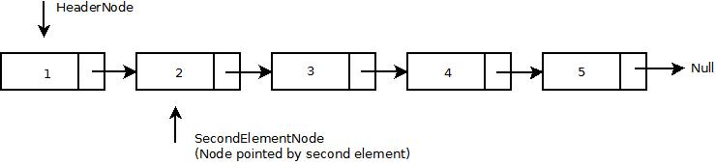
Basic Types of Linked List
Singly linked lists
A linked list structure in which each node has a pointer to its successor.
A Game:
The last row of the students stand up.
How to construct a singly linked list?
Do you know your successor?
Do you know your predecessor?
How to find the first node?
How to find the last node?

Slide 7
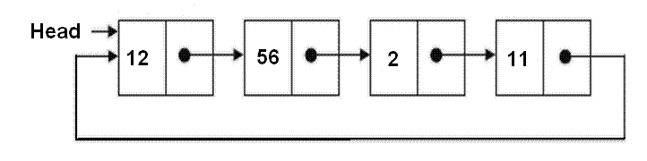
Basic Types of Linked List
Circularly linked lists
A linked list structure in which the last node’s link points to the first node of the list.
A Game:
The students in the 2nd row from last stand up.
How to construct a circularly linked list?
Do you know your successor?
Do you know your predecessor?
How to find the first node?
How to find the last node?

Slide 8
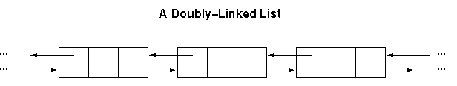
Basic Types of Linked List
Doubly linked lists
A linked list structure in which each node has a pointer to both its successor and its predecessor.
A Game:
The students in the 3rd row from last stand up.
How to construct a doubly linked list?
Do you know your successor?
Do you know your predecessor?
How to find the first node?
How to find the last node?

Slide 9
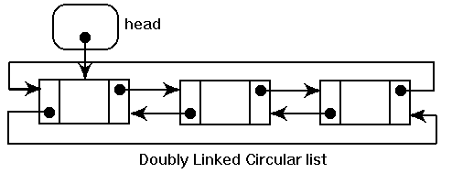
Basic Types of Linked List
Doubly linked circular list
A combination of doubly linked list and circularly linked list.
A Game:
The students in the 4th row from last stand up.
How to construct a doubly linked circular list?
Do you know your successor?
Do you know your predecessor?
How to find the first node?
How to find the last node?

Slide 10
Basic Operations
Insertion
Ordered list
Random list
Deletion
Locate the node
Remove it from the list
Retrieval
Locate a given node
Traversal
Go through each element in the list
We’ll mainly work on singly linked list !

Slide 11

Creation & Insertion
Linked List Operations – singly linked list
Create a list
Insert a node

Slide 12
List Structure
List structure
struct list {
int count;
struct node *head;
};
count

Slide 13
A Node Structure
Data node
Example
struct node{
int data; // we use int as example
struct node *next;
};
data
next

Slide 14
Create list
Allocate a list and initialize it.
Code:
Check out the pseudocode
from your textbook
0
pList
count
head
struct list *CreateList()
{
struct list *pList;
pList = malloc(sizeof(struct list));
assert(pList! = NULL);
pList-> count = 0;
pList-> head = NULL;
return pList;
}

Slide 15
Insert A Node
void insert(struct list *plist, struct node *pPrev, struct node *pNew)
{
}

Slide 16
Allocate Memory for a New Node
pNew
Data next
Code
We need to allocate memory every time when we generate a new node. It’s the same process. So we omit it in the later discussions.
struct node *pNew;
pNew = malloc(sizeof(struct node));
assert(pNew!=NULL);
pNew -> data = val;

Slide 17
Link the Node to the List
Assume we have already created a linked list and allocated memory for the new node.
In order to insert a node, what do you need to know?
Predecessor
Successor

Slide 18
Link the Node to the List
Different situations:
Insert in middle
Predecessor (yes)
Successor (yes)
Insert at end
Predecessor (yes)
Successor (no)
Insert into empty list
Predecessor (no)
Successor (no)
Insert at beginning
Predecessor (no)
Successor (yes)
Be careful about the pointer manipulations!

Slide 19
Insert in Middle
Now we have a list with several nodes, and we want to add a new node in the middle of the list.
pNew
Data next
pList
Count head
Data next
Data next
pPre
Manipulate two pointers:
pNew-> next & pPre->next

Slide 20
Code
pNew-> next = pPre->next;
pPre->next= pNew;
pList-> count++;

Slide 21
Insert at End
Now we have a list with several nodes, and we want to add a new node at the end of the list.
pNew
Data next
Count head
Data next
pPrev
Manipulate two pointers:
pNew-> next & pPre->next

Slide 22
Code
pNew-> next = NULL;
pPre->next= pNew;
pList-> count++;
pNew-> next = pPre->next;
pPre->next= pNew;
pList-> count++;

Slide 23
Link the Node to the List
Different situations:
Insert in middle
Predecessor (yes)
Successor (yes)
Insert at end
Predecessor (yes)
Successor (no)
Insert into empty list
Predecessor (no)
Successor (no)
Insert at beginning
Predecessor (no)
Successor (yes)
We know the previous node!
No actual node before the new node!

Slide 24
Insert at Beginning
Now we have a list with one/several node(s), and we want to add a new node at the beginning of the list.
pNew
Data next
Count head
Data next
pList
Manipulate two pointers:
pNew-> next & pList->head

Slide 25
Code
pNew-> next = pList->head;
pList ->head = pNew;
pList-> count++;

Slide 26
Insert into Empty List
An empty list has the list structure only.
pNew
Data next
Count head
pList
Manipulate two pointers:
pNew-> next & pList->head
Notes:
Allocate memory
I point to the new student
The new student point to null.

Slide 27
Code
pNew-> next = NULL;
pList ->head = pNew;
pList-> count++;
Is it the same as
pNew-> next = pList->head;
pList ->head = pNew;
pList-> count++;
Yes. So we can use the same code for these two cases. Yay!

Slide 28
As a Summary
We are able to combine case 1 & 2;
We are able to combine case 3 & 4.
YAY!

Slide 29
Insert Items in Linked List
void insert(struct list *plist, struct node *pPrev, struct node *pNew) {
//pPrev = NULL if inserting as first node;
if (pPrev == NULL) { //cases 3 & 4
pNew->next = pList->head;
pList->head = pNew;
} else {
pNew->next = pPrev->next;
pPrev->next = pNew;
}
pList->count++;
}
What is the big O?
O(1), only when pPrev is given
What is missing?
Notes:
O(1)

Slide 30
Insert Items in Linked List
void insert(struct list *pList, struct node *pPrev, struct node *pNew) {
assert(pList != NULL && pNew != NULL);
if (pPrev == NULL) { /* empty list or first node */
pNew->next = pList->head;
pList->head = pNew;
} else { /* at end or in middle */
pNew->next = pPrev->next;
pPrev->next = pNew;
};
pList->count++;
}

Slide 31
A New Question
Can we do something even better?

